Slide 1

Semusi Technology
Assessment
CREATED BY:
Manan Patel

Slide 2
Contents
Problem Statement
Dataset
Approach
Code Snippets
Results

Slide 3
Problem Statement
Building a new Employee Security System to decide using previously recorded features whether we need to predict whether to open door for the person or not from its gait analysis.

Slide 4
Dataset
Dataset given with the problem statement was named as Human Activity Recognition with Smartphones.
Where each data contains 561 features and Label is whether its was recorded while Sitting, Walking, Standing, Walking Downstairs/Upstairs and Laying and we have to predict these classes for new data.
Custom dataset using Physics Toolbox was created by me to check the model with new data.
We can use this for our security system because each person will have this unique way of walking, stopping etc. But for this task we will only be training and testing on given dataset and our custom dataset.

Slide 5
Approach
We will train our dataset using Supervised Machine Learning Algorithms like SVM and Random Forest as number of features is large.
We will also experiment with dataset by trying to drop certain features with relatively low correlation with our Label.
For custom dataset using Physics Toolbox, which gives us 4 columns , We will make more features defined by the dataset maker such as Mean, Min, Max, etc. which should leave us with 561 features to test our trained model.
Due to several reasons I was not able to code for all 561 features so, i only wrote code to generate 89 features but for sake of testing the dataset I filled the rest with random values which will give us wrong prediction.

Slide 6
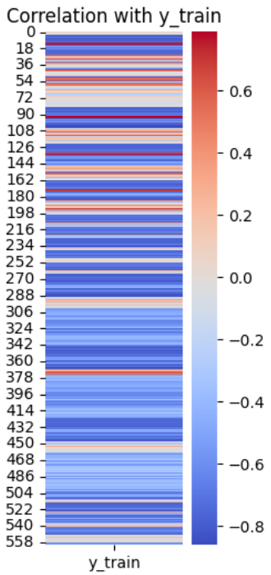
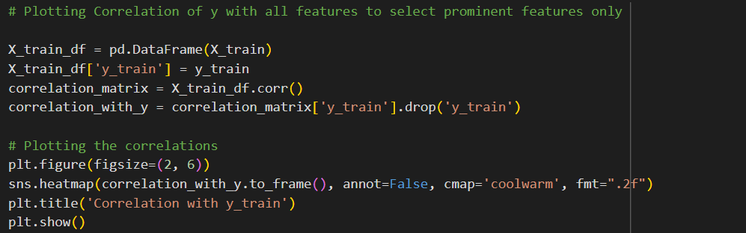
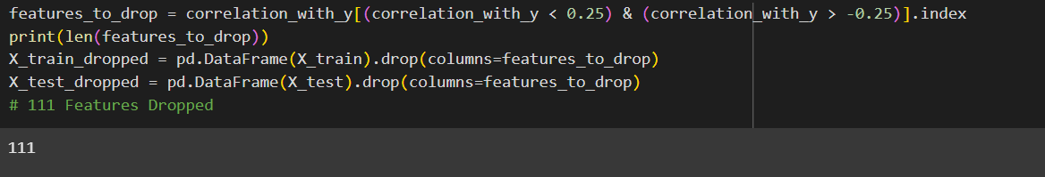
Code Snippets
*Kindly Look at the attached Notebook for more result
Correlation with our Label

Slide 7
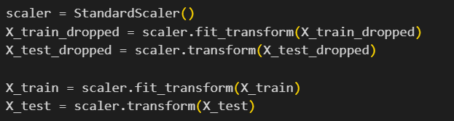
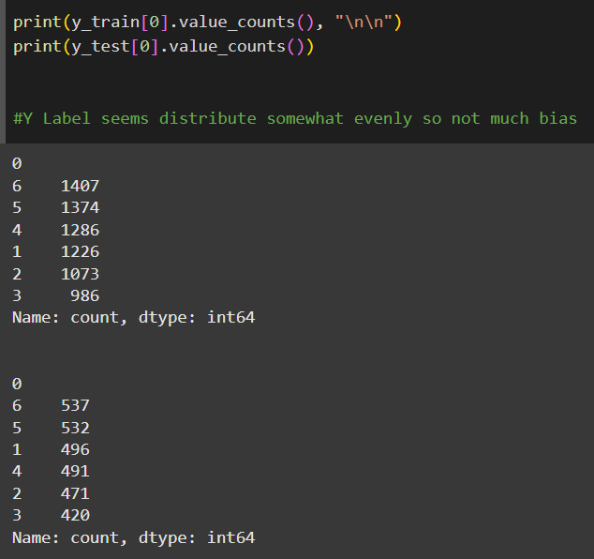
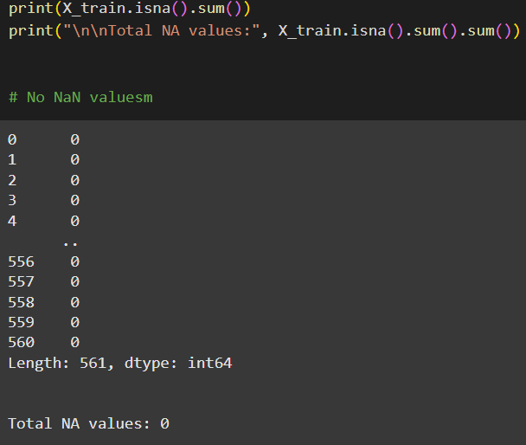
Code Snippets
Scaling our data
Checking for dataset biasness
Checking for NaN values
*Kindly Look at the attached Notebook for more result

Slide 8
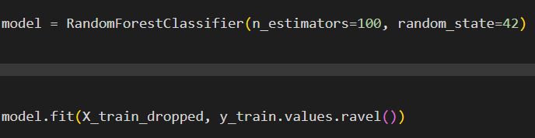
Code Snippets
*Kindly Look at the attached Notebook for more result
Random Forest Model
SVM Model

Slide 9
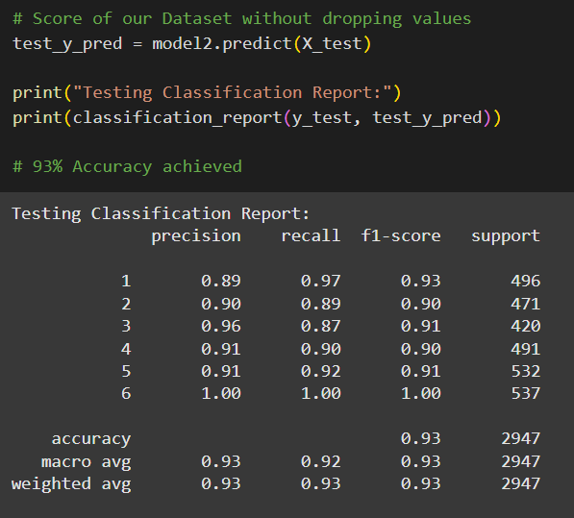
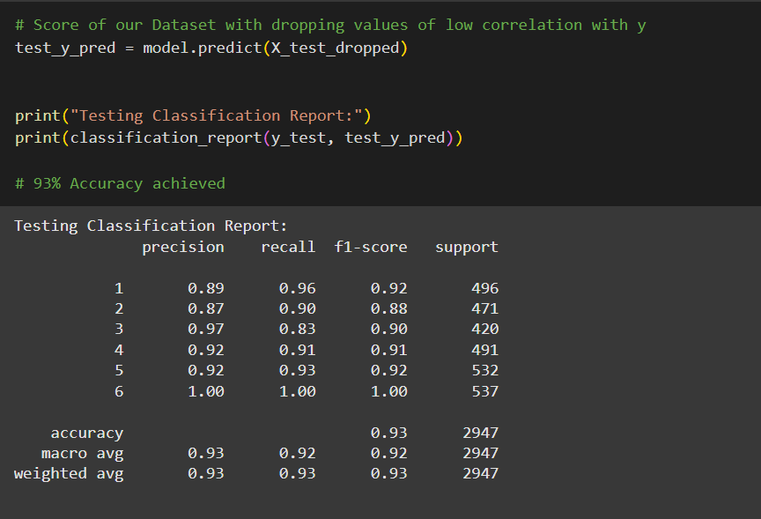
Results
*Kindly Look at the attached Notebook for more result
Random Forest without
dropping columns
Random Forest with
dropping columns

Slide 10
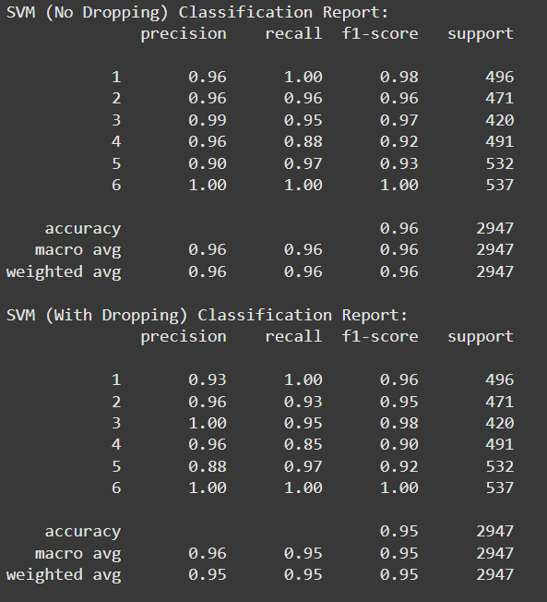
Results
*Kindly Look at the attached Notebook for more result
SVM Result with Linear Kernel Function
as this was giving the best result
over other kernel functions

Slide 11
Conclusion
We can conclude that it is possible to classify employees at check-in using their smartphone by taking data from Physics Toolbox and then sending it to our model(with the required pre-processing) for class prediction about the identity of the person. If it matches with some previous data then we let them in.
This could improve the checking experience with great accuracy(security).

